Slide 1
BANK ANALYSIS REPORT
GROUP 5
TEAM MEMBERS
TRIVENI
PRIYA SUBHASHRAO JADHAV
PRATEEKSHA HP
ARYA KOTHADIYA
SAKSHI BHAGWAN DOIJAD
PURNIMA GOPAL SALVANKAR
K NEELESH

Slide 2
EXECUTIVE SUMMARY
Objective: Analyze $470M+ in total payments to identify growth drivers.​
Growth: Massive portfolio scaling from $22M (2007) to $241M (2011).
​Risk Profile: Concentration of revolving balances in Grade B borrowers.
​Verification Impact: Verified loans outperform non-verified in repayment volume.​
Market Dominance: California and Texas remain the primary revenue engines.​

Slide 3
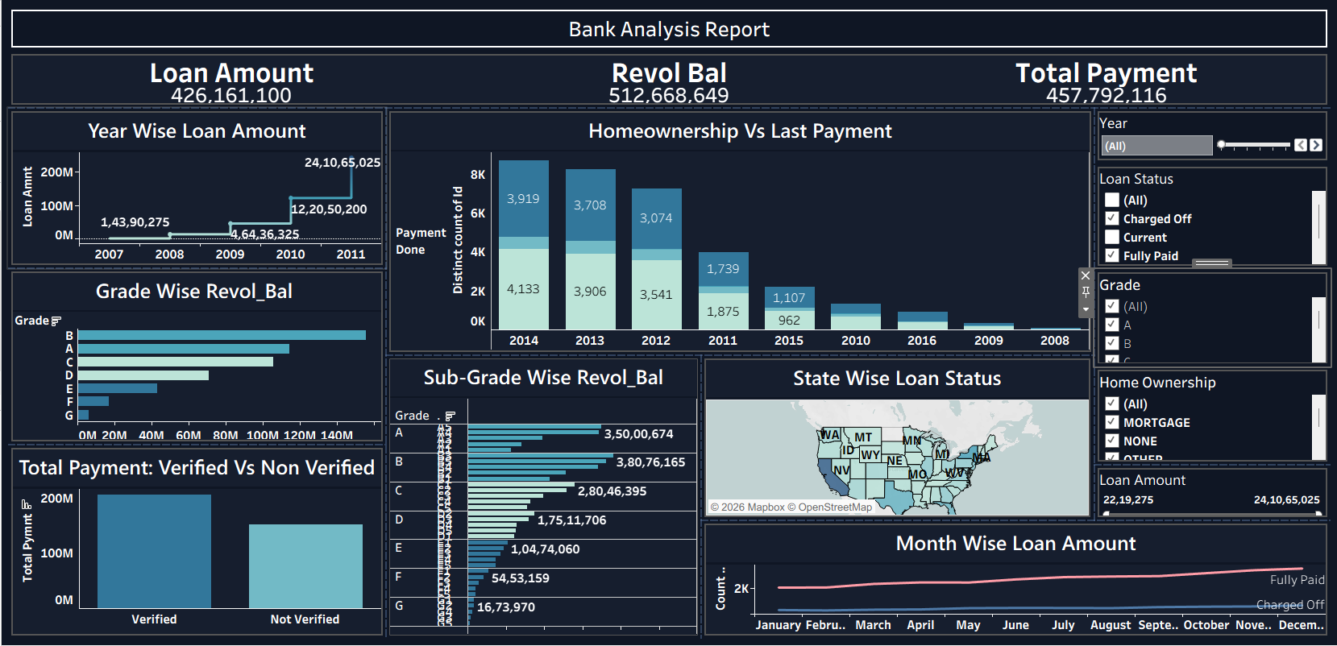

Slide 4
YEAR WISE LOAN AMOUNT STATS
Exponential Surge: Loan amounts grew 10x over the 5-year period.​
Stability: Consistent growth despite the 2008 global financial crisis.
​Peak Performance: 2011 represents the highest disbursement year (~$241M).
​Trend Strength: The upward curve suggests high market confidence.

Slide 5
GRADE & SUB-GRADE WISE REVOLVING BALANCE
Grade B Leadership: Holds the largest revolving balance (~$161M).​
Sub-Grade Depth: B3 is the highest-volume sub-category in the bank.
​Risk Tiering: Grades A, B, and C account for the bulk of the portfolio.​
Conservative High-Risk: Very low balances in Grades F and G (tight lending).​
Balance Insight: Higher revolving balances correlate with mid-tier credit grades.

Slide 6
TOTAL PAYMENT: VERIFIED VS. NON-VERIFIED
Revenue Split: Verified borrowers contribute 58.88% of total payments.
​Payment Gap: Verified payments are nearly ~$100M higher than non-verified.​
Reliability: Verification status is a primary indicator of higher repayment.
​Scale: Total payments reached nearly $473M across both categories.​
Strategic Value: Verification reduces the bank's "unknown" risk variables.

Slide 7
STATE-WISE & MONTH-WISE LOAN STATUS
​CA & TX Dominance: California is the largest market by a wide margin.​
Year-End Peak: Loan volumes spike every year in Q4 (October–December).​
Default Ratios: "Fully Paid" counts remain high even as volume grows.​
Geographic Spread: Heavy concentration on the West Coast and East Coast.​
Seasonal Opportunity: December shows the highest monthly loan activity.

Slide 8
HOME OWNERSHIP VS. LAST PAYMENT STATS
Renter/Mortgage Split: 92% of our borrowers are Renters or Mortgage holders.
​Homeowners: Only 7% of our borrowers actually "Own" their homes.​
Payment Recency: A huge spike in final payments occurred in late 2014.​
Portfolio Stability: Renters and Mortgage holders show nearly equal payment counts.​
Market Insight: Our core customer is the "Working Professional" living in a rental or financed home.

Slide 9
STATE-WISE & MONTH-WISE LOAN STATUS
CA & TX Dominance: California is the largest market by a wide margin.
​Year-End Peak: Loan volumes spike every year in Q4 (October–December).​
Default Ratios: "Fully Paid" counts remain high even as volume grows.​
Geographic Spread: Heavy concentration on the West Coast and East Coast.
​Seasonal Opportunity: December shows the highest monthly loan activity.

Slide 10
HOME OWNERSHIP VS. LAST PAYMENT STATS
Renter/Mortgage Split: 92% of our borrowers are Renters or Mortgage holders.
​Homeowners: Only 7% of our borrowers actually "Own" their homes.​
Payment Recency: A huge spike in final payments occurred in late 2014.​
Portfolio Stability: Renters and Mortgage holders show nearly equal payment counts.
​Market Insight: Our core customer is the "Working Professional" living in a rental or financed home.

Slide 11
KEY OBSERVATIONS
Unprecedented Growth: 10x increase in loan volume from 2007 to 2011.​
Verification is King: Verified users are significantly more profitable.​
Middle-Class Core: Our revenue is driven by Renters and Mortgage holders.​
Regional Dependence: A significant portion of our risk is tied to the California economy.​
Tiered Risk: High revolving balances in Grade B suggest a need for interest rate optimization.

Slide 12
SUGGESTIONS
Mandatory Verification: Require verification for any loan over $15k to secure the portfolio.​
Incentivize Homeowners: Create a "Homeowner Discount" to increase that 7% segment.​
Regional Expansion: Launch a campaign in the Midwest to reduce CA/TX concentration.
​Seasonal Staffing: Hire temporary support in Q4 to handle the December loan surge.​
B3-Specific Review: Conduct a deeper risk audit on the B3 sub-grade due to its high balance.

Slide 13
CONCLUSION
​ The bank is in a strong growth phase with a high-performing "Verified" segment.​
"By shifting toward stricter verification and geographic diversity, we can maintain this growth while lowering our default risk."

Slide 14
THANK YOU

